Slide 1
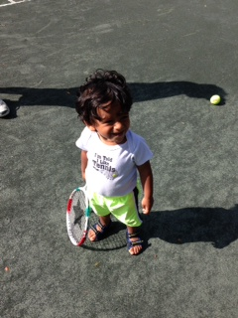
Sports Specialization in Tennis
Neeru Jayanthi, M.D., USPTA Associate Professor Orthopaedics and Family Medicine
Director, Tennis Medicine President, STMS
WTA player development medical advisory board
Emory University Sports Medicine Atlanta, GA USA
STMS-Web.org

Slide 2
Too early for doubles?

Slide 3
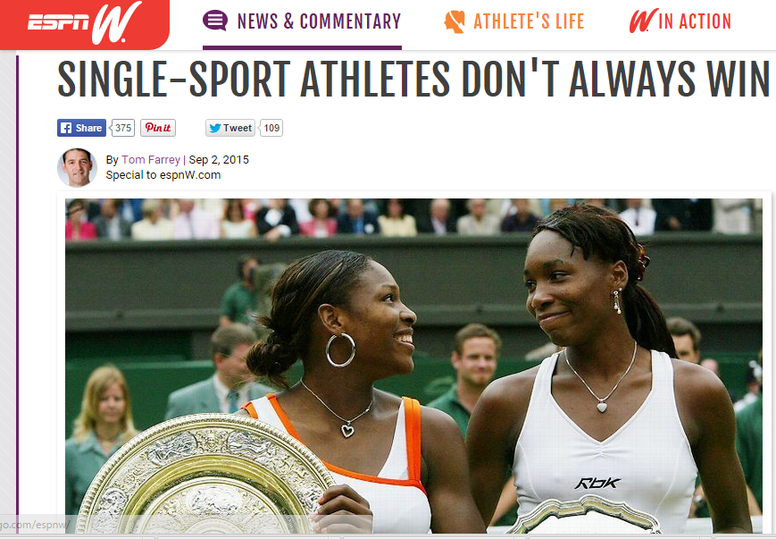

Slide 4
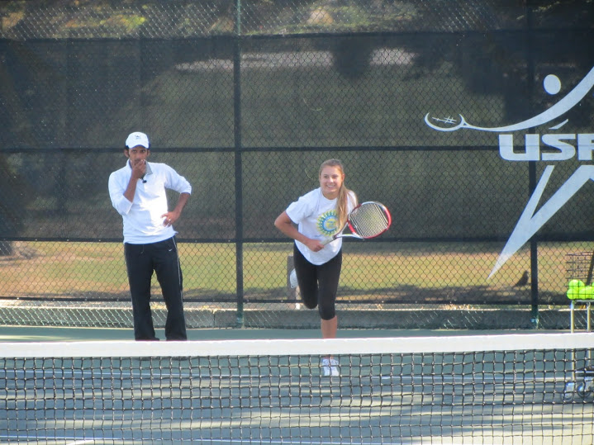
INJURY PREVENTION
No known interventional study on injury prevention in junior elite tennis players!...

Slide 5
Training profiles of US Junior Elite
Median 16-20 hours/week training
11-25 tournaments/year
70% specialized in tennis
Mean age 10.4
Jayanthi et al, Journal Med Sci Ten 2009

Slide 6
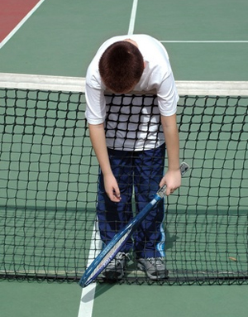
US JUNIOR TENNIS
We have no self-regulation of injury risk in US junior tennis
There is a volume-based point ranking system

Slide 7
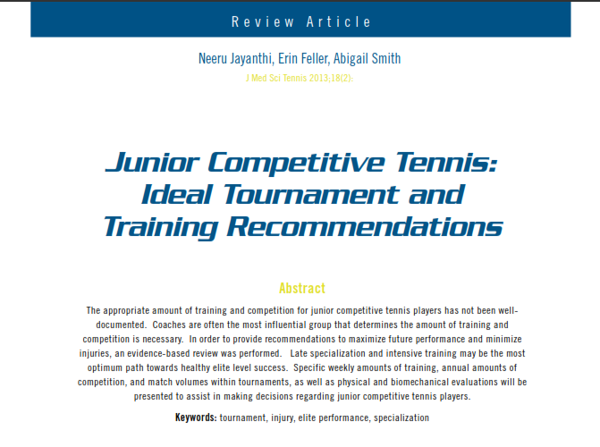
Injury Prevention Recommendations
Competition
Within a tournament
Annual match/tournament volume
Training
Weekly volumes
Off court injury prevention
Biomechanical risks
Strokes
Individual risks
Screening
Specialization

Slide 8
Ideal Training Program
12 y/o junior tournament player
< 12 hrs/week
<12 tourn/yr
Possibly consider another sport (soccer) with an off-season for tennis
2+ hrs/week injury prevention training, etc.
THIS IS NOT POSSIBLE IN CURRENT RANKING SYSTEM TO MAINTAIN A HIGH RANKING

Slide 9
Summary of Recommendations
Exercise caution in junior tournament players competing in their fifth match and beyond, particularly in older age divisions (SORT Level B)
Reduce size of some tournaments to Round of 32 or 64
Consider having at least 1-2 hours between same day matches to allow for sufficient recovery. (SORT Level B)
Cancel consolation for extreme heat conditions
Caution when playing >10 hours/week history of prior injury, particularly in the low back and before a tournament (SORT Level B).
Participate in less tennis hrs/week then your age to prevent overuse injury (SORT B)
Consider delaying specialization in tennis until middle or late adolescence for injury prevention as well as for successful performance (SORT Level B)
There may be a risk of early specialization in tennis.
Consider delaying specialization beyond pre pubescent ages.
Reduce your sports training ratio <2:1
Annually, consider playing <40 competitive SINGLES matches/year (SORT C)
Consider 1-2 tournaments/month (SORT C)
Recommendation: Delay kick serve until after age 13 to reduce stressful loads (SORT C)

Slide 10
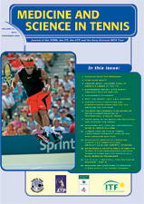
Training and sports specialization risks in junior elite tennis players
Neeru Jayanthi, MD
Amanda Dechert, MS2
Amy Luke, PhD
Ramon Durazo-Arvisu, PhD
Loyola Stritch School of Medicine

Slide 11
Methods
Design: Prospective cohort study
498 did NOT medically withdraw
540 players consented
519 sufficiently completed baseline survey
21 medically withdrew
Summer Tournament Play
Notes:
After IRB Approval & Informed consent, we distributed surveys to the players. Those that withdrew were given post-match evaluations to determine the reason for their withdrawal
11

Slide 12
“Training and Sports Specialization Risks in Junior Elite Tennis Players,” Jayanthi, Dechert, Luke et al.

Slide 13
Results
Increased medical withdrawal
risk and:
Players who specialize only in tennis
Mean age 10.4 (70%)
(p = 0.047)
Players who have had an injury or illness in the past year
(p < 0.001) (5.4x increase)
Playing >16 hours week may be risk factor for development of medical withdrawal

Slide 14
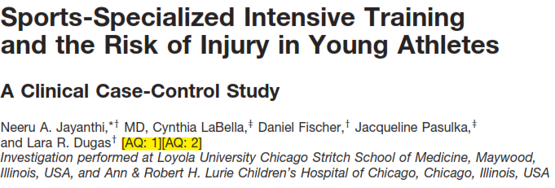
SPORTS PHYSICALS
(UNINJURED)
SPORTS INJURY
(INJURED)

Slide 15
Defining Sports Specialization
Intense Year Round Training in a Single Sport at the exclusion of other sports
Jayanthi et al., DiFiori et al.
Year round training/competition> 8 months)
Quit all other sports to focus on one sport
Choose a main sport

Slide 16
Rates and Degrees of Specialization
38%
34%
Jayanthi, et al.

Slide 17
Sports Specialization Rates (Tennis)
baseball
basketball
cheerleading
cross country
dance
diving
football
gymnastics
lacrosse
soccer
softball
swimming
tennis
track & field
volleyball
wrestling
Highly specialized
15.42%
20.51%
28.30%
27.62%
25%
38.46%
12.32%
32.97%
26%
26.56%
22.89%
21.50%
47.95%
21.84%
24.18%
12.20%
Low specialization
50.25%
47.34%
41.51%
43.81%
34.72%
30.77%
50.74%
21.98%
42%
39.06%
45.78%
45.79%
20.55%
44.83%
43.79%
48.78%
baseball
basketball
cheerleading
cross country
dance
diving
football
gymnastics
lacrosse
soccer
softball
swimming
tennis
track & field
volleyball
wrestling
F

Slide 18
Organized weekly training (Tennis)
Weekly hours in organized sport
10.69
10.11
9.57
9.98
10.15
12
11.26
11.91
10.85
8.6
10.78
11.45
11.12
10.99
10.05
11.89
baseball
basketball
cheerleading
cross country
dance
diving
football
gymnastics
lacrosse
soccer
softball
swimming
tennis
track & field
volleyball
wrestling
D

Slide 19
Recreational/free play (Tennis)
Weekly hours in free play
7.33
6.45
5.54
4.86
4.56
4.15
7.45
5.6
7.12
5.78
5.7
6.3
3.73
5.95
5.08
6.07
F
baseball
basketball
cheerleading
cross country
dance
diving
football
gymnastics
lacrosse
soccer
softball
swimming
tennis
track & field
volleyball
wrestling

Slide 20
Sports Training Ratio (Tennis)
baseball
basketball
cheerleading
cross country
dance
diving
football
gymnastics
lacrosse
soccer
softball
swimming
tennis
track & field
volleyball
wrestling
Sports training ratio
1.5
1.6
1.7
2.1
2.2
2.9
1.5
2.1
1.5
1.5
1.9
1.8
3.0
1.8
2.0
2.0
F

Slide 21
% Injured (Tennis)
baseball
basketball
cheerleading
cross country
dance
diving
football
gymnastics
lacrosse
soccer
softball
swimming
tennis
track & field
volleyball
wrestling
Percentage Injured
64.71%
68.04%
73.21%
70.64%
68.42%
69.23%
67.12%
70.97%
60%
67.29%
73.56%
55.45%
83.89%
78.02%
70.55%
76.60%
F

Slide 22
% Overuse Injuries (Tennis)
baseball
basketball
cheerleading
cross country
dance
diving
football
gymnastics
lacrosse
soccer
softball
swimming
tennis
track & field
volleyball
wrestling
% Overuse Injuries
64.78%
62.86%
53.66%
74.02%
63.46%
55.55%
49.33%
78.78%
48.28%
60.11%
68.75%
65.58%
80.00%
63.38%
63.47%
36.11%
F

Slide 23
% Serious Overuse Injuries (Tennis)
baseball
basketball
cheerleading
cross country
dance
diving
football
gymnastics
lacrosse
soccer
softball
swimming
tennis
track & field
volleyball
wrestling
ISerious Overuse
14.08%
13.57%
26.83%
15.58%
15.38%
33.33%
16.22%
28.78%
6.90%
12.92%
12.50%
8.20%
20.80%
9.86%
12.17%
13.89%
D

Slide 24
Overall Report Card (Tennis vs other sports)
F
% Injured
% Overuse Injuries
% Serious Overuse Injuries
Sports Specialization Rates
Organized weekly training
Recreational/free play
Sports Training Ratio
F
D
F
F
D
F
Overall grade for diversified sports training and healthy participation:
F

Slide 25
Competitive Tennis players
Main sport tennis (N=91)
Diversified Tennis (N=59)
13.1 ± 2.4 yr
89.0% injured (81/91)
Specialization Score 2.6 ± 0.6
Total hrs: 17.7 ± 6.1 hrs/wk
Tennis: 12.5 ± 5.1 hrs/wk
Free/rec: 2.8 ± 3.3 hrs/wk
Sports training ratio: 4.5
77.3% injured (45/59)
Specialization Score: 1.8 ± 0.8
Total hrs: 17.1 ± 7.6 hrs/wk
Tennis: 9.1 ± 4.6 hrs/wk
Free/rec: 5.1 ± 4.7 hrs/wk
Sports training ratio: 1.8
14.7 ± 1.9 yr

Slide 26
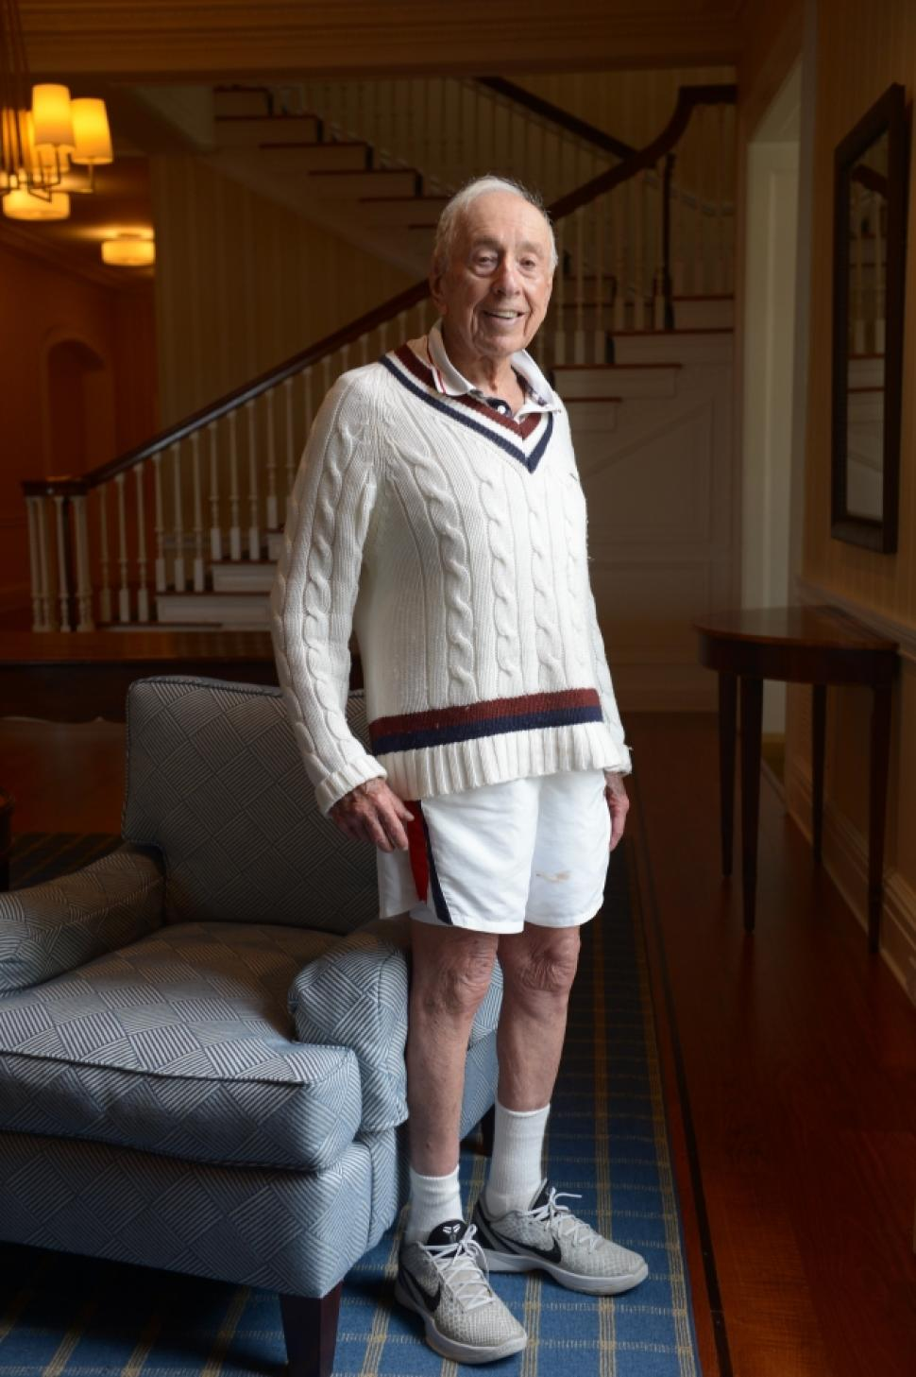
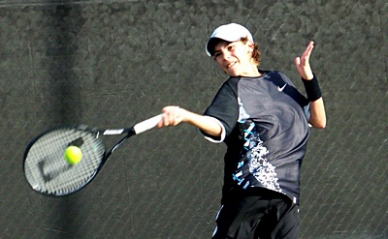
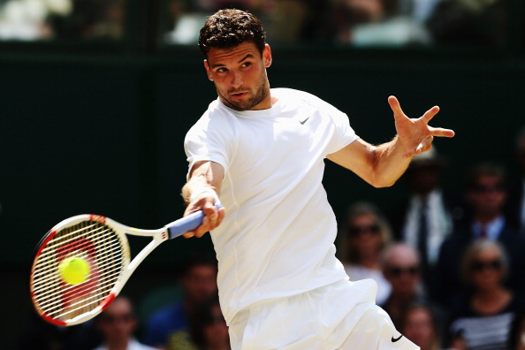
What message should we send about tennis: Tennis across the lifespan

Slide 27
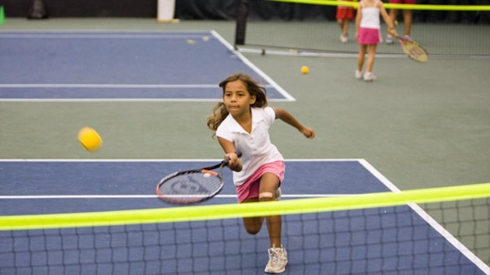
10 and under tennis
What effect will this have on cumulative volume in the next generation of elite juniors?

Slide 28
Early introduction, Late specialization
Brian hainline (former USTA CMO)
Business aspect (loss of revenue?)
Similar to decreased reimbursement
“This does not apply to my sport”
2 different pathways
1% elite level player development path
Majority of young athletes

Slide 29
LEVELS OF JUNIOR PLAYER

Slide 30
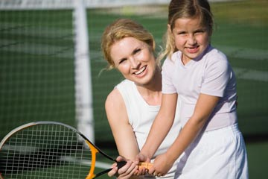
Health Status of Parent-Child Dyads

Slide 31
Child’s energy expenditure

Slide 32
Parents Energy expenditure

Slide 33
Parent child study
Parents of kids who are active in sports and the kids both meet ACSM exercises guidelines.
Parents of multi sport athletes spend 3-4 x as much exercise/week with their kids then parents of specialized kids.

Slide 34
USTA Junior tennis can lead the way for youth sports!

Slide 35
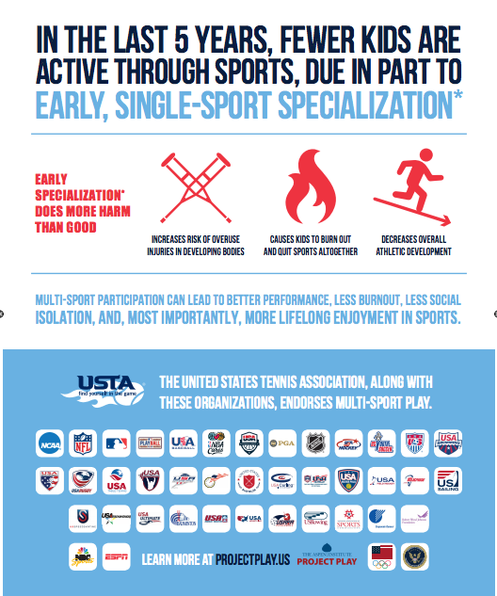

Slide 36
Proposal for USTA-junior tennis
Longitudinal study (tennis specific) evaluating stroke efficiency and training volume and specialization as factors for performance and injury risk

Slide 37
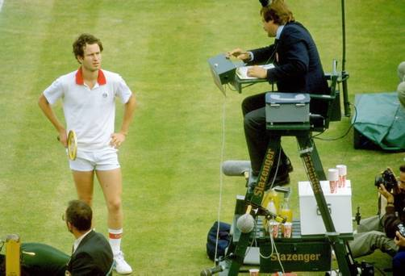
Thank You!
IOC WORLD CONFERENCE PREVENTION OF INJURY AND ILLNESS IN SPORT

